Slide 1




Practice-based psychotherapy research network
JM Thurin
jmthurin@techniques-psychotherapiques.org

Slide 2
Practice-based psychotherapy research network : Organisation
Coordinators
  B Falissard et JM Thurin
Communication
  M Thurin
Support for statistics
  Tiba Baroukh
Pole Autism
  Pr B Golse, Dr G Haag,
  Pr C Barthélémy
Scientific comitee
  C Barthélemy, R Blanc, B Golse, G Haag, L Robel, H Suarez-Labat, M Thurin, JM Thurin
Pole Borderline
Pole Alzheimer

Slide 3
Practice-based psychotherapy research network : Methodology
Process – outcome intensive case studies secondarily gathered with similar cases
Moderators
CIM 10
CARS
or
ADI
Sceno test
BECS
Or
WISC
Parental
alliance
age
Beginning
2 months
6 months
1 year
Extensive notes of the first 3 hours
Extensive notes of two hours
Extensive notes of two hours
Extensive notes of two hours
ECAR
GRCEEAIT
ECAR
GRCEEAIT
CPQ
ECAR
GRCEEAIT
CPQ
ECAR
GRCEEAIT
CPQ
Case formulation
Case formulation

Slide 4
Case formulation
Current problems of the child, their place in the context of its situation of current life, its history and its development
Non dynamic factors which can have contributed to its problem
Synthetic integration of the available data opening with an interpretation of the precipitating factors and the influences which maintain the problems of the child
First definition of the goal and the intermediate objectives of psychotherapy and the strategy to reach them

Slide 5
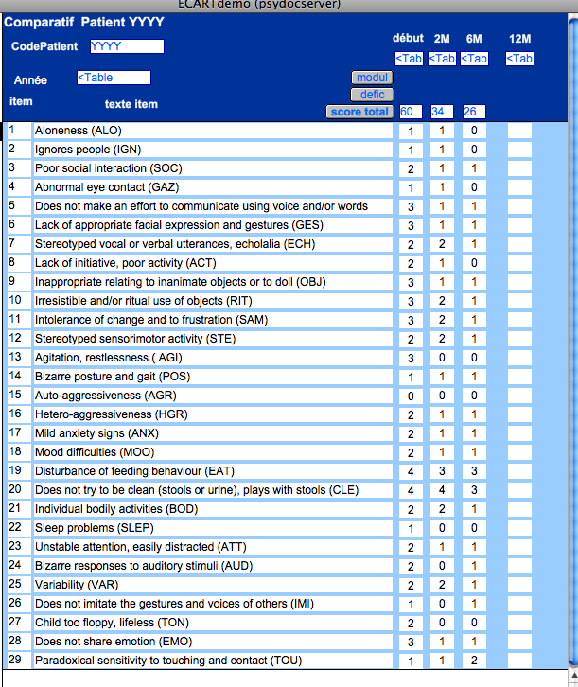
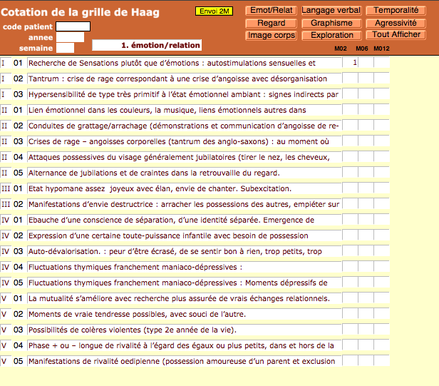
Specific tools of the pole autism (1/2)
Quantitative Evaluation of Autistic Behaviour in Developmentally Disordered Children (BSE-R) (Barthelemy and Lelord)
→ 29 items: symptoms and behaviors
→ 2 principal factors: relational deficiency
modulating insufficiency
Clinical Location of the Evolutionary Stages of the Infantile Autism Scale (CLESIAS) (Haag and al.)
→ 147 items in 5 levels of development
→ 8 dimensions: emotional expressions in the relation (20 items)
regard (15 items)
image of the body (31 items)
verbal language (20 items)
graphics (17 items)
exploration of space and the objects (26 items)
temporal location (9 items)
aggressive demonstrations (9 items)

Slide 6
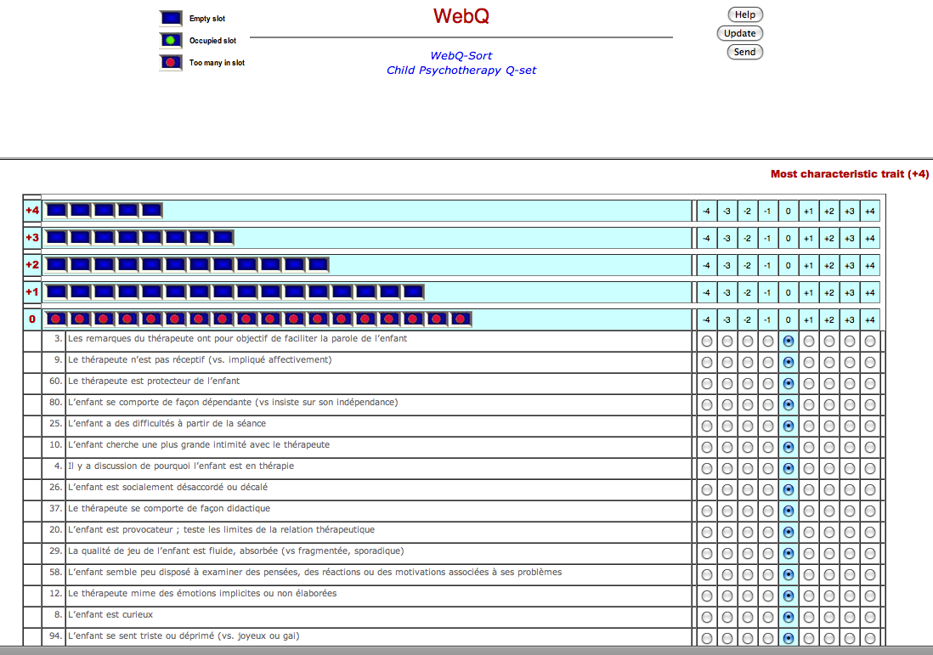
Les outils spécifiques au pôle autisme (2/2)
The Child Psychotherapy Q-Set from Celeste Schneider and Enrico Jones
→ 100 items
→ 2 principal factors:
psychodynamic therapy
cognitivo - behavioral therapy
→ 3 characteristics of the psychotherapy process:
interaction,
adjustment,
engagement

Slide 7





Working in pairs’ groups
  It can be done on the work place or remote (via Internet)
    Each clinician follows one or two of its cases. He or she analyzes the changes which occur and the factors which contribute to them across the data collected during the sessions.
    For each case, the psychotherapist and 2 or 3 other clinicians join together in a pairs’ group. They are subjected, as for the data of their own patient to the professional secrecy.
    In a pairs’ group : the role of the participants is clearly identified. For example: they are all clinicians (3 to 4 people), they share data resulting from one or two cases which they are committed following throughout one year. From the corpus of some hours, they compare with various times their analyzes and their quotations.

Slide 8
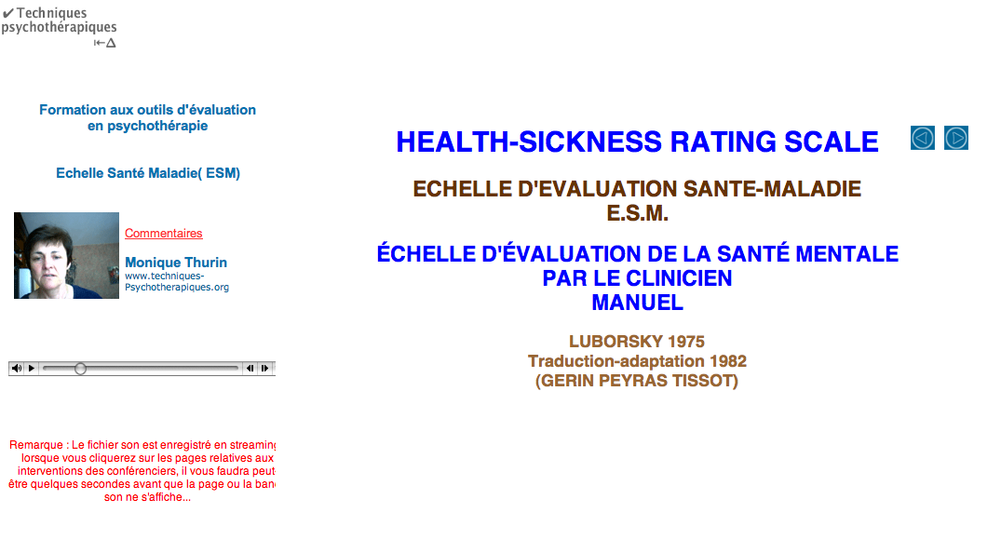
Training

Slide 9
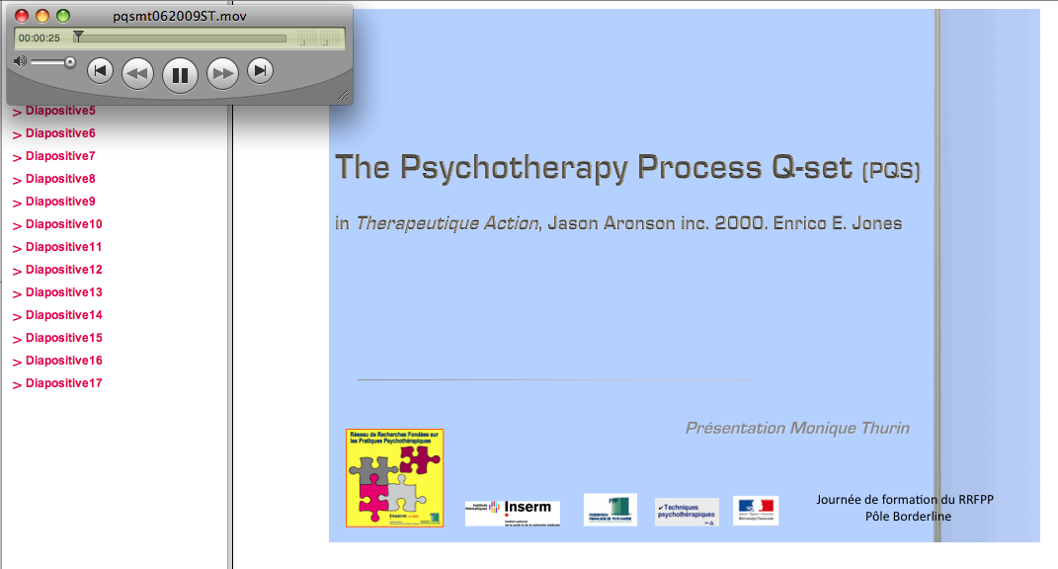

Training

Slide 10
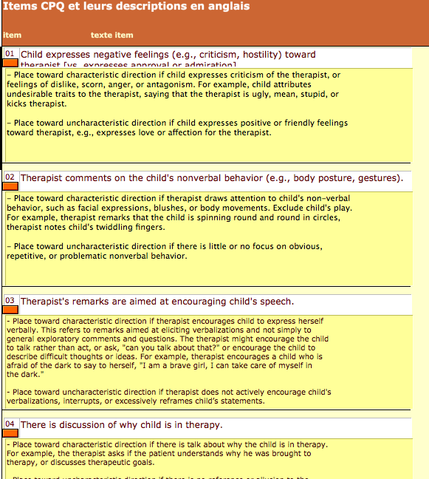
Rating on line

Slide 11


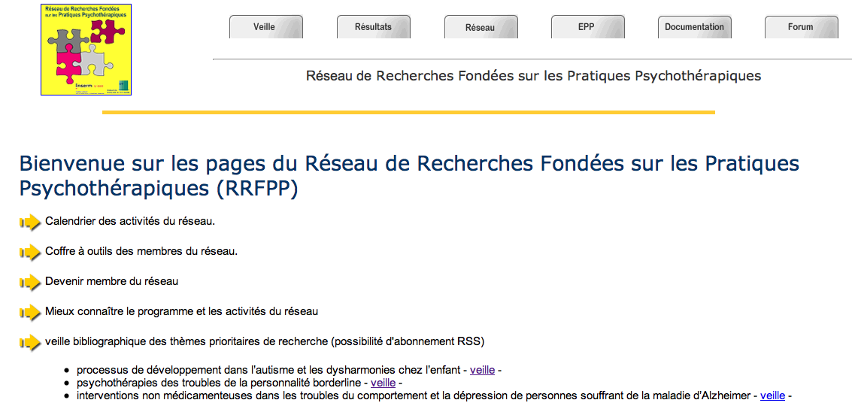
More always more …
www.techniques-psychotherapiques.org/reseau/
04/07/08. JM Thurin

